Slide 1



Past and present dynamics of the circumbinary moons in the Pluto-Charon system
Cristian Giuppone ⁽²⁾
Adrián Rodríguez ⁽²⁾, Tatiana Michtchenko ⁽³⁾, Amaury de Almeida⁽³⁾
⁽¹⁾ IATE- Observatorio Astronómico, Universidad Nacional de Córdoba, Argentina
⁽²⁾ Observatório do Valongo, Universidade Federal do Rio de Janeiro ⁽³⁾ Instituto de Astronomia, Geofísica e Ciências Atmosféricas, Universidade de Sao Paulo, Brasil

Slide 2
Aim: find a favourable scenario that can explain the positions of small moons of Pluto at their current positions.
Outline
Formation theories Pluto
Pluto-Charon
Pluto-Charon + Moons
Dynamics of circumbinary moons around PC
Tidal expansion of PC
Tidal expansion of PC and surrounding particles
Dynamics and survival scenario for surrounding particles

Slide 3
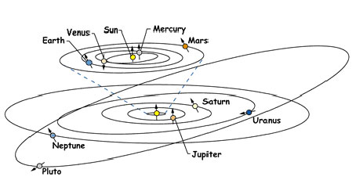
Pluto orbit

Slide 4
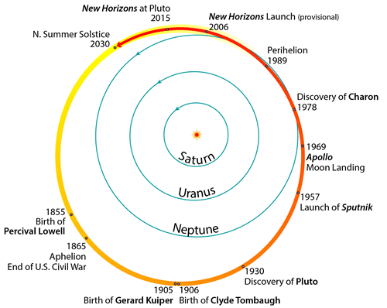
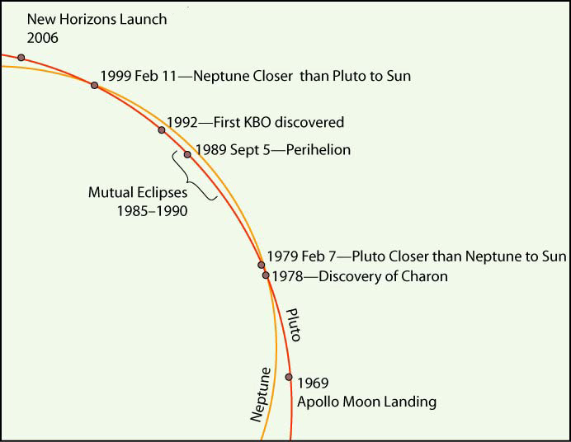
Pluto - orbit and origin
Pluto’s eccentric and inclined orbit in the 3:2 MMR with Neptune could have originated either:
. from interactions among bodies accreting near Pluto’s current semimajor axis (Levison and Stern, 1995)
. from formation of Pluto at a more interior distance, with Pluto then driven outward into its current orbit via resonant transport as Neptune’s orbit expanded (Malhotra, 1993, 1995; Malhotra and Williams,
1997). 𝜏_{e} ~ 10⁶ yr

Slide 5
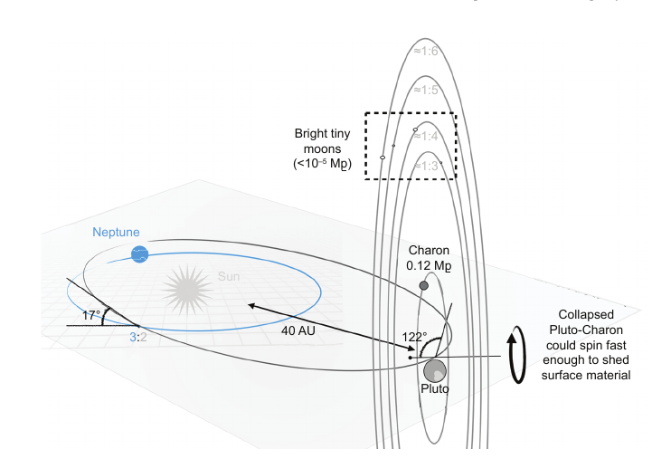
Pluto - orbit and origin

Slide 6
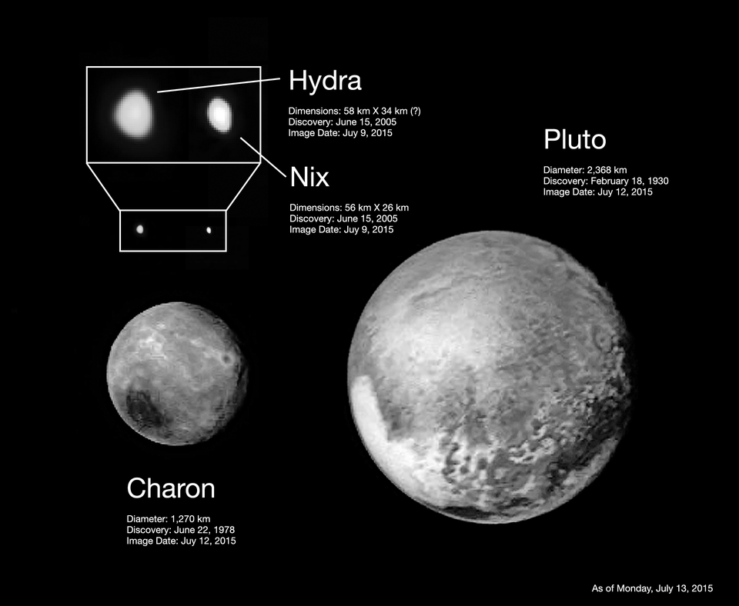
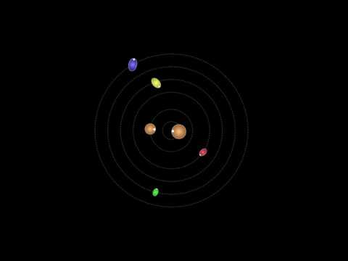
Pluto - Charon
Spherical shapes.
Pluto R_{P} = 1188 km , m_{P} = 1.303 × 10²² kg
Charon R_{P} = 606 km , m_{P} = 1.59 × 10²¹ kg
q = 0.1165 (mass ratio)
Showalter noted that the spin rates of these moons are similar to those of other objects in a vast reservoir of frozen bodies, known as the Kuiper Belt, which lies beyond the orbit of Neptune and which includes the Pluto system. Kuiper Belt objects are thought to have acquired their rapid rotation through collisions with other icy debris in the reservoir.
“No one has ever seen a moon [like Hydra] that rotates 89 times during a single orbit.”

Slide 7
Pluto - Charon
Pluto and Charon are on a close, tidally locked, and essentially circular orbit (e~10⁻⁵) that is coplanar. The binary is in tidal equilibrium. In this dual synchronous state, the rotational day of both bodies is equal to their mutual orbital period, P = 6.3872 days.
Aditional moons
The outer moons have nearly circular and co-planar orbits, and they orbit Pluto in the same sense and plane as Charon, which seems to strongly suggest that they share a common origin with the binary (e.g., Stern et al., 2006).
Their surfaces are unusually bright and ice-rich compared with other similarly sized Kuiper belt objects (KBOs). If, seems probable, their interiors are similarly dominated water ice, this is consistent with the small moons having originated from debris dispersed during a Charon-forming impact (e.g., Canup, 2011).
Crater counts indicate that Pluto, Charon, Nix, and Hydra are probably all ancient bodies, with oldest surface ages roughly estimated to ≥4 Gyr. but still subject to uncertainties in the impactor population
(Robbins et al., 2017; Singer et al., 2019).

Slide 8
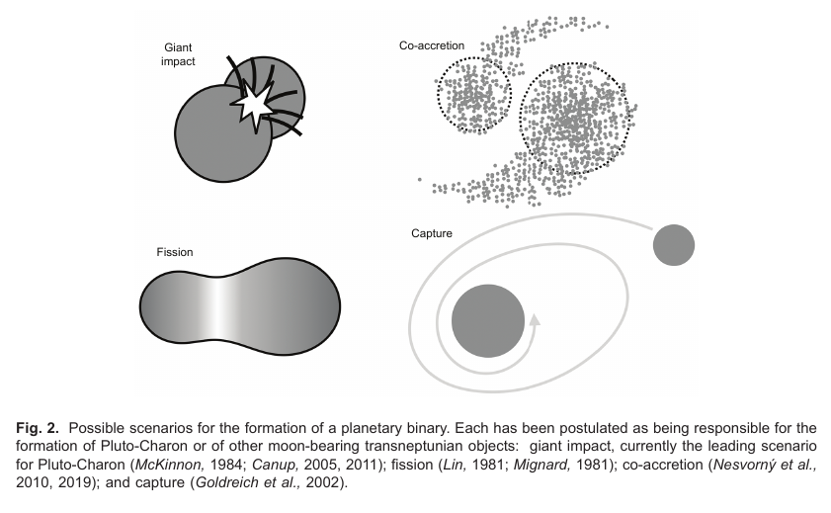
Pluto - Charon
Origin of the system?

Slide 9
Pluto - Charon
Co-accretion would produce moons with compositions similar to those
of Pluto and Charon, and this appears inconsistent with their currently inferred ice-rich compositions
Origin of the system?
Fission of a fast-spinning Pluto could explain a result-
ing high-angular-momentum binary. However is more easily explained with giant impact
Capture of much larger Charon appears to require an improbably dense disk (Stern et al., 2018)

Slide 10
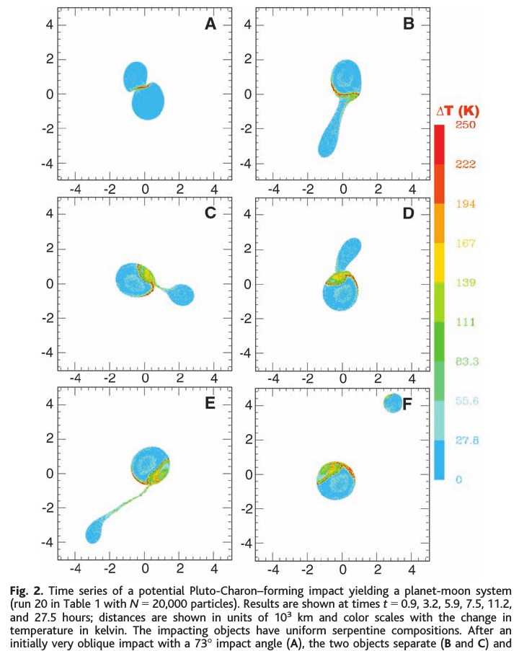
Pluto - Charon
Origin of the system? Gian impact
SPH integrations Canup 2005, 2011.
A narrow range of collisions can produce a moon with q ≥ 0.1.
Requires a very large, oblique impact (often in combination with some pre-impact rotation) in order to maximize the total angular momentum, together with a low impact velocity to minimize the escaping mass and maximize the retained angular momentum.
Higher-impact velocity collisions that result in substantial mass loss can form large satellites, but no cases that yield q ≥ 0.1 have been found

Slide 11
Pluto - Charon
Origin of the system? Gian impact
SPH integrations Canup 2005, 2011.
A narrow range of collisions can produce a moon with q ≥ 0.1.
Requires a very large, oblique impact (often in combination with some pre-impact rotation) in order to maximize the total angular momentum, together with a low impact velocity to minimize the escaping mass and maximize the retained angular momentum.
Higher-impact velocity collisions that result in substantial mass loss can form large satellites, but no cases that yield q ≥ 0.1 have been found

Slide 12
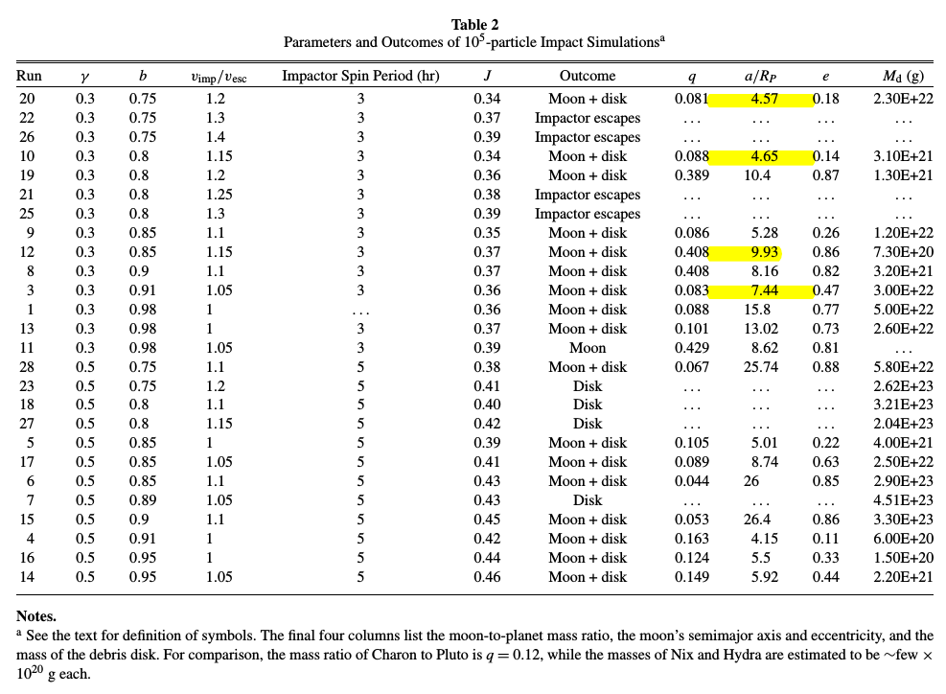
Pluto - Charon
Origin of the system? Gian impact
SPH integrations Canup 2005, 2011.
A narrow range of collisions can produce a moon with q ≥ 0.1.
Requires a very large, oblique impact (often in combination with some pre-impact rotation) in order to maximize the total angular momentum, together with a low impact velocity to minimize the escaping mass and maximize the retained angular momentum.
Higher-impact velocity collisions that result in substantial mass loss can form large satellites, but no cases that yield q ≥ 0.1 have been found

Slide 13
Outline
Formation theories Pluto
Pluto-Charon
Pluto-Charon + Moons
Dynamics of circumbinary moons around PC
Tidal expansion of PC
Tidal expansion of PC and surrounding particles
Dynamics and survival scenario for surrounding particles

Slide 14
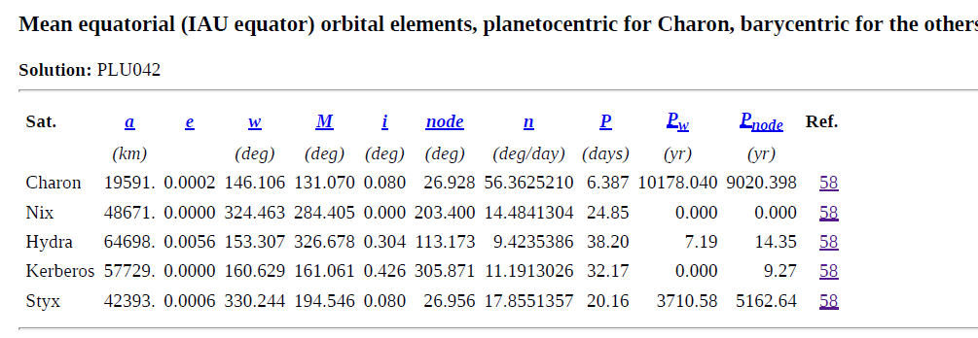
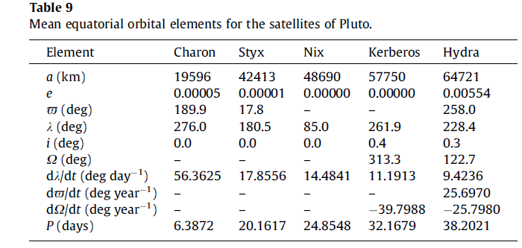
Initial Conditions
JPL - 2019
Brozovic+2015
Brozovic+2015

Slide 15
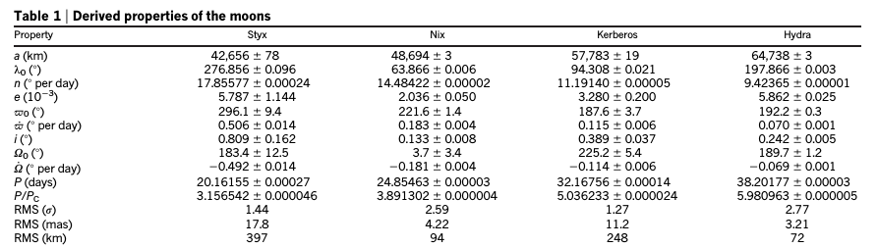
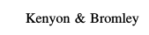
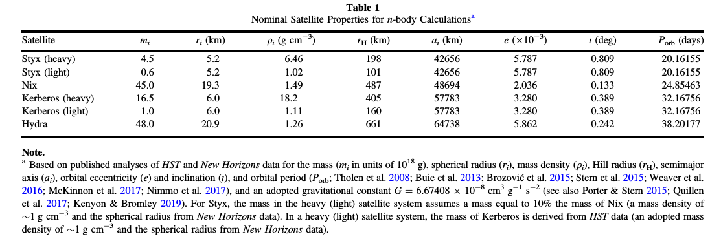
Initial Conditions
Showalter+Hamilton+2015
JPL - 2019
Brozovic+2015

Slide 16
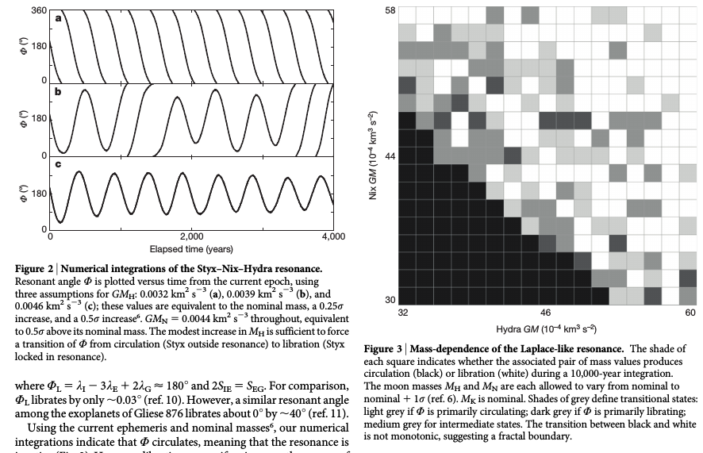
UNLIKELY

Slide 17
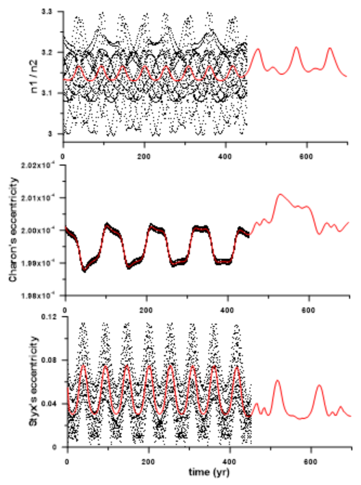
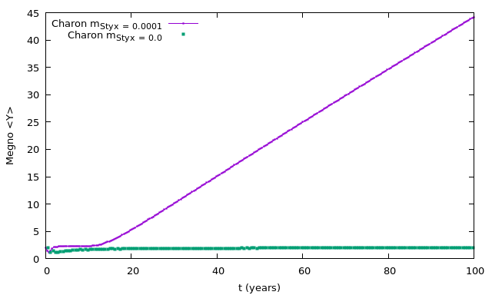
Initial Conditions - Wide
Pluto - Charon - Styx

Slide 18
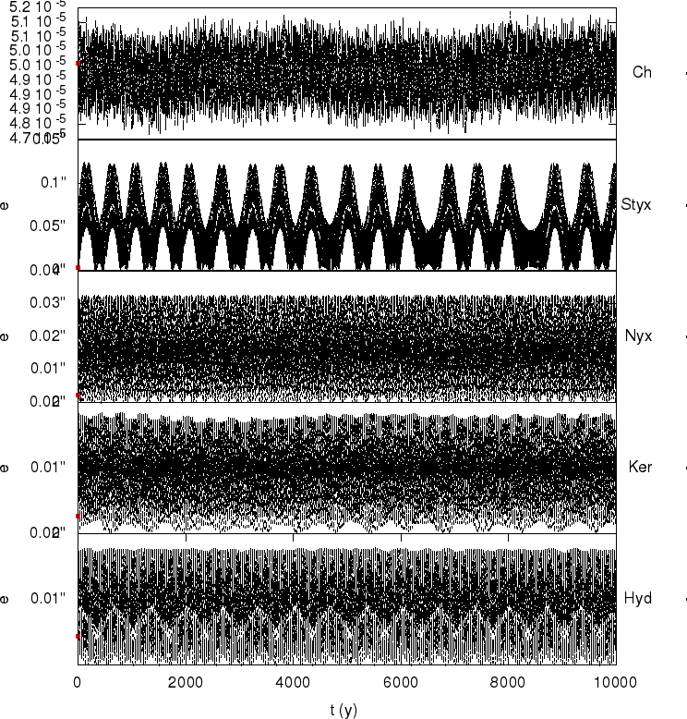
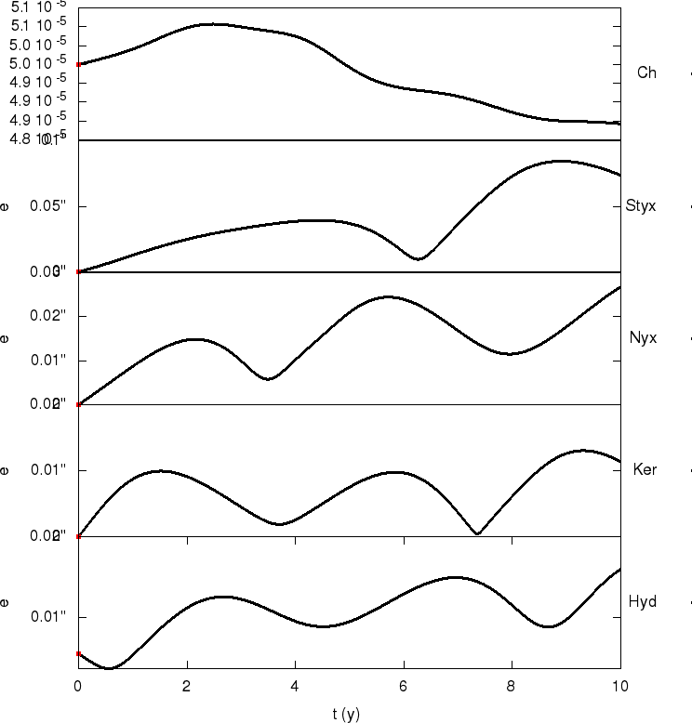
Initial Conditions - Full system

Slide 19
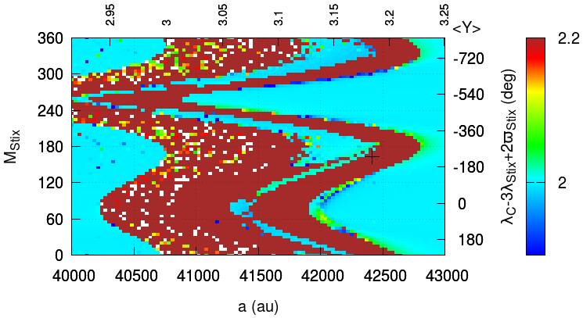
Initial Conditions
mass=0

Slide 20
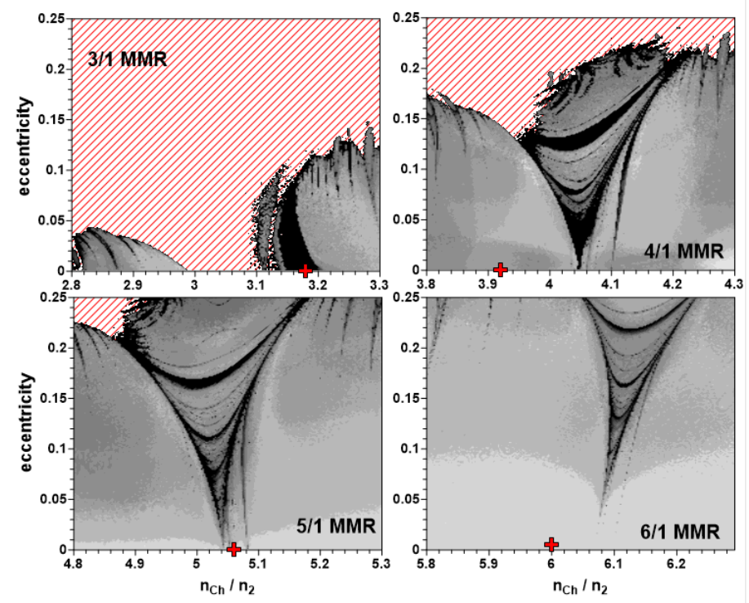
Maps of the individual MMRs. All orbital elements are Jacobian. The positions of the moons are shown by red crosses.

Slide 21
Pluto - Charon
Origin of the system? Gian impact
SPH integrations Canup 2005, 2011.
A narrow range of collisions can produce a moon with q ≥ 0.1.
Requires a very large, oblique impact (often in combination with some pre-impact rotation) in order to maximize the total angular momentum, together with a low impact velocity to minimize the escaping mass and maximize the retained angular momentum.
Higher-impact velocity collisions that result in substantial mass loss can form large satellites, but no cases that yield q ≥ 0.1 have been found

Slide 22
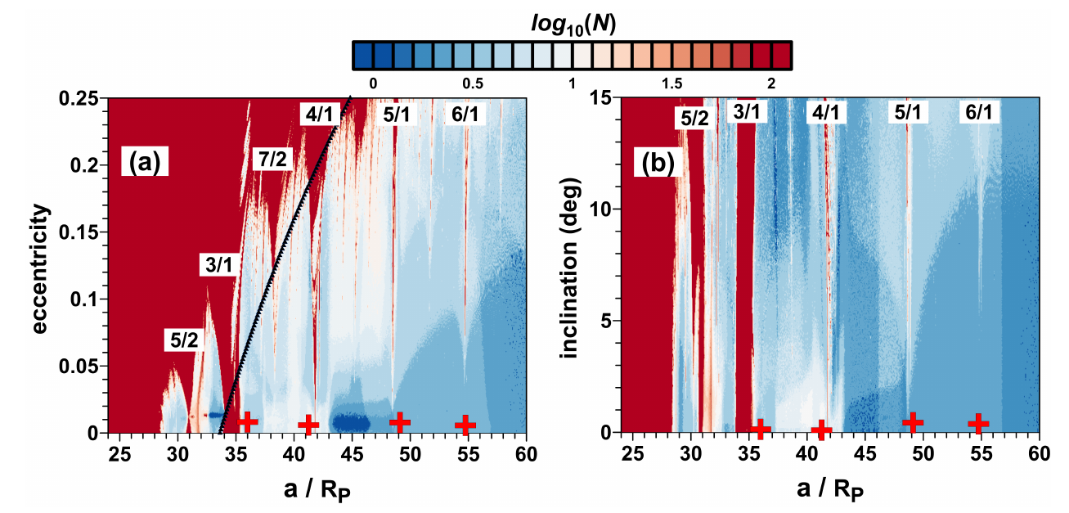
Pluto - Charon and moons

Slide 23
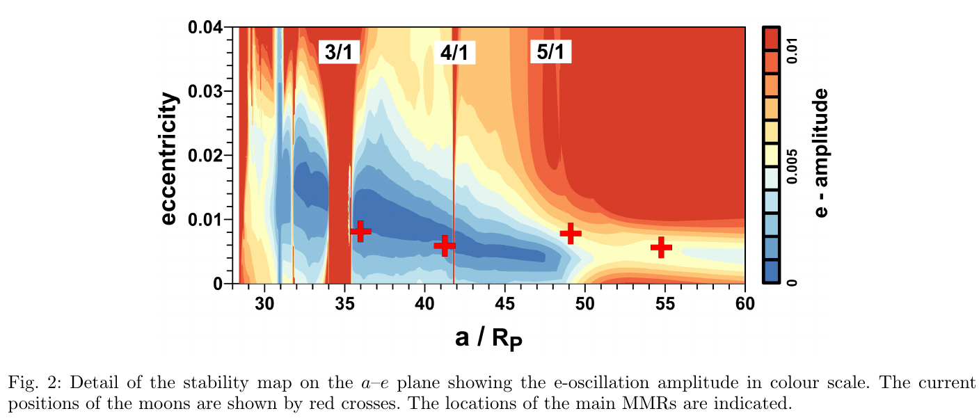
Pluto - Charon and moons
It is worth emphasising that the uncertainties in the determination of the moon’s masses and the actual positions can provide a general view of the phase space of the PC system, but not specifying whether the objects are evolving nearby or inside the MMRs.
Smooth migration process?

Slide 24
Outline
Formation theories Pluto
Pluto-Charon
Pluto-Charon + Moons
Dynamics of circumbinary moons around PC
Tidal expansion of PC
Tidal expansion of PC and surrounding particles
Dynamics and survival scenario for surrounding particles

Slide 25
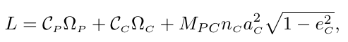
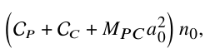
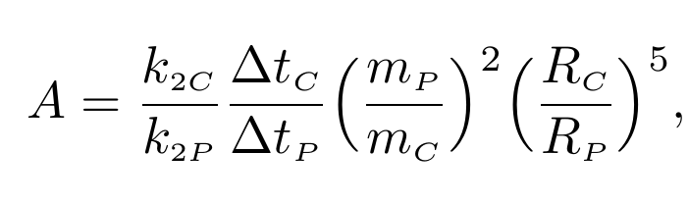
Tidal evolution and conservation AM
at dual synchronous state of the current PC binary, the Charon’s orbit is circularised, that is, we
can assume e_{C} = 0, and Ω_{P} =Ω_{C} =n_{C} .
Using L_{in}=L_{now}, we can set initial conditions for the tidal evolution at L_{in} →
e_{C} = ?
Ω_{P} = ?
a_{C} = ?
Ω_{C} /n_{C} = 2
L_{now} ~
Initial conditions:
e_{C} = 0.01, 0.1 or 0.2
Ω_{P} = ? (from L conservation)
a_{C} = 4 R_{p}
Ω_{C} /n_{C} = 2
Final conditions:
e_{C} ~ 0
Ω_{P} = Ω_{C} = n_{C} (dual synchronous)
a_{C} = 16.5 R_{p}
Using we w we can parametrize the tidal dissipation by means of
~2

Slide 26
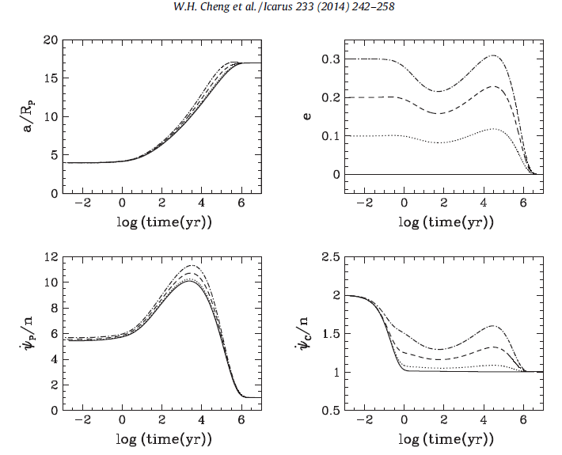
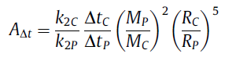
Tidal evolution PC
Max(e) = Max(psi_dot/n)
Pseudo-syncronous state. Constant Dt ?
A_{(Δt)}=3. Rp=1153 km, Rc=606 km,
k_{2P} = 0.058
Δt_{P}=600 s
k_{2C} = 0.058
Δt_{C}=2217 s

Slide 27
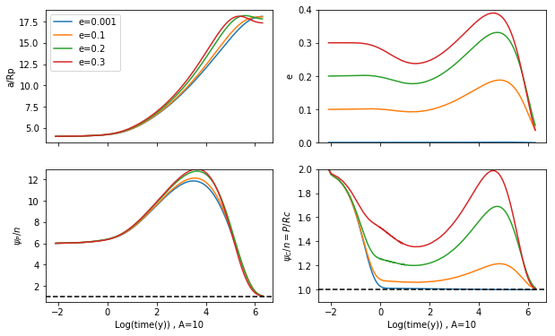
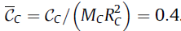
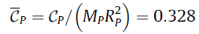
Max(e) = Max(psi_dot/n)
Tidal Evolution.
Our results
A_{(Δt)}=3. Rp=1153 km, Rc=606 km,
k_{2P} = 0.058
Δt_{P}=600 s
A_{(Δt)}=3. Rp=1153 km, Rc=606 km,
k_{2P} = 0.058
Δt_{P}=600 s
k_{2C} = 0.058
Δt_{C}=2217 s
k_{2C} = 0.058
Δt_{C}=2217 s

Slide 28
Outline
Formation theories Pluto
Pluto-Charon
Pluto-Charon + Moons
Dynamics of circumbinary moons around PC
Tidal expansion of PC
Tidal expansion of PC and surrounding particles
Dynamics and survival scenario for surrounding particles

Slide 29
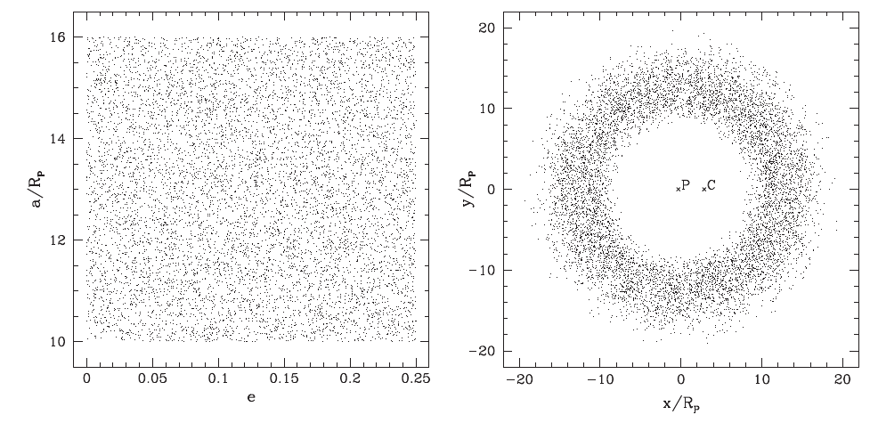
Particles Chen (Tidal Transport)
Tidal Evolution.
A_{(Δt)}=3. Rp=1153 km, Rc=606 km,
k_{2P} = 0.058
Δt_{P}=600 s
k_{2C} = 0.058
Δt_{C}=2217 s

Slide 30
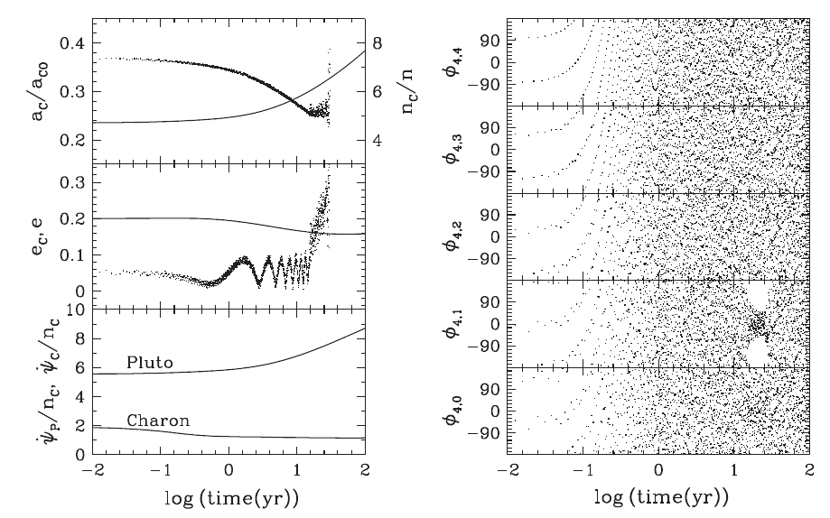
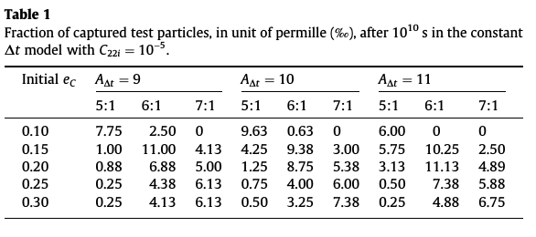
Particles Chen (Tidal Transport)
Tidal Evolution.
Unlikely

Slide 31
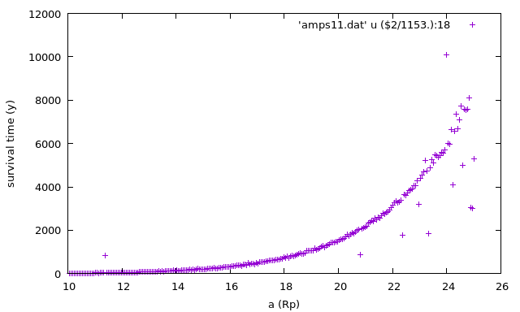
Tidal Evolution of Pluto + Charonte + Ring of particles.
10000 years (4 Rp to 12.5 Rp)
Extended ring of particles not survived more than 8000 years (Charon still did not get its final a)
Particles Chen+ (Tidal Transport)
A_{(Δt)}=3. Rp=1153 km, Rc=606 km,
k_{2P} = 0.058
Δt_{P}=600 s
k_{2C} = 0.058
Δt_{C}=2217 s

Slide 32
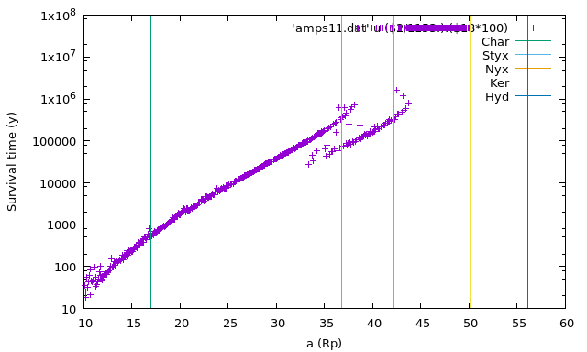
Tidal Evolution of Pluto + Charonte + Ring of particles.
10000 years (4 Rp to 12.5 Rp)
Tidal Evolution of Pluto + Charonte + Ring of particles.
A_{(Δt)}=3. Rp=1153 km, Rc=606 km,
k_{2P} = 0.058
Δt_{P}=600 s
k_{2C} = 0.058
Δt_{C}=2217 s

Slide 33
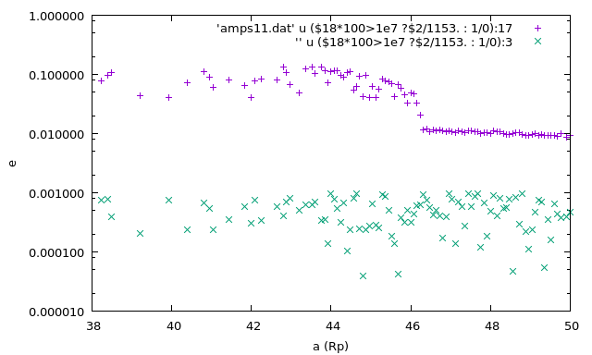
Tidal Evolution of Pluto + Charonte + Ring of particles.
10000 years (4 Rp to 12.5 Rp)
Tidal Evolution of Pluto + Charonte + Ring of particles.

Slide 34
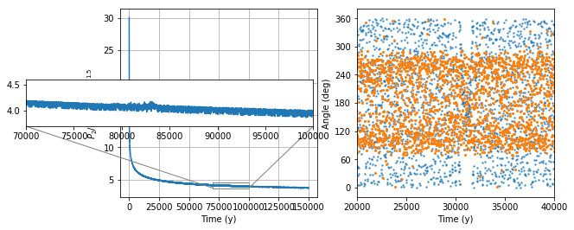
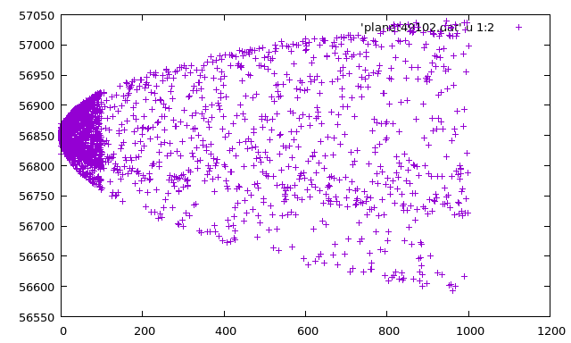
Tidal Evolution of
Pluto + Charon + particle
The particle (small moon) do not tidally expand!!!

Slide 35
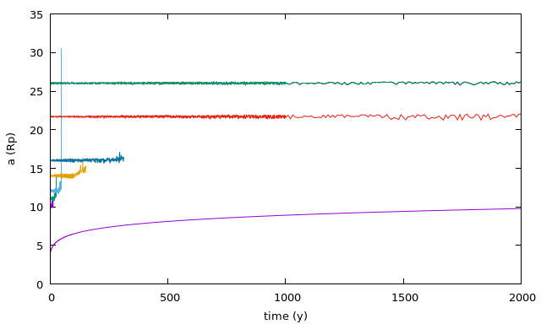
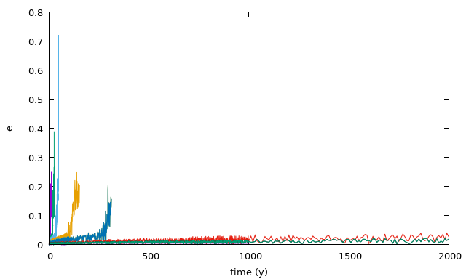
Initial conditions examples
Fast depletion due to fast evolution of a_{c}
Semiaxis of Charon
Tidal Evolution.

Slide 36
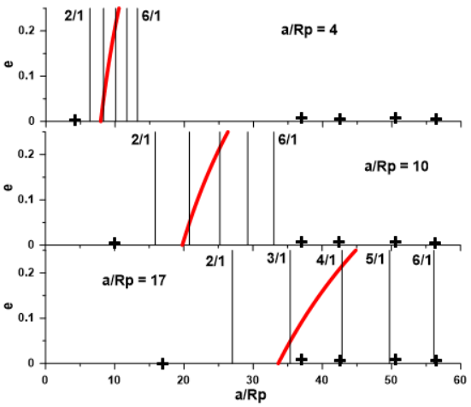
Tidal Evolution → Expansion of orbits

Slide 37
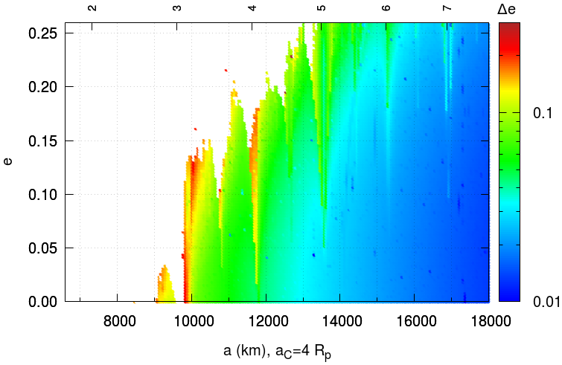
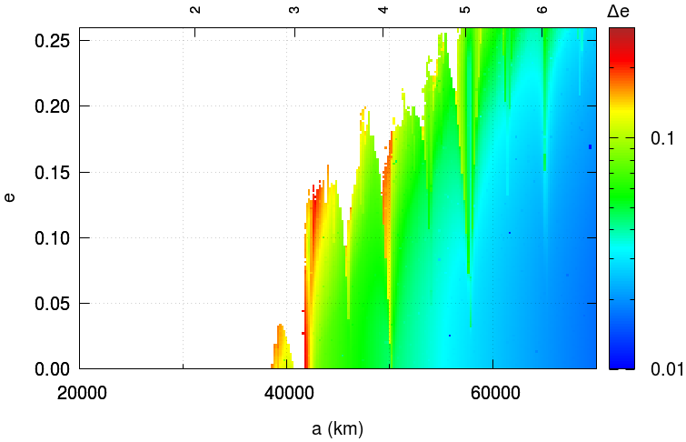
Tidal Evolution → Expansion of orbits

Slide 38
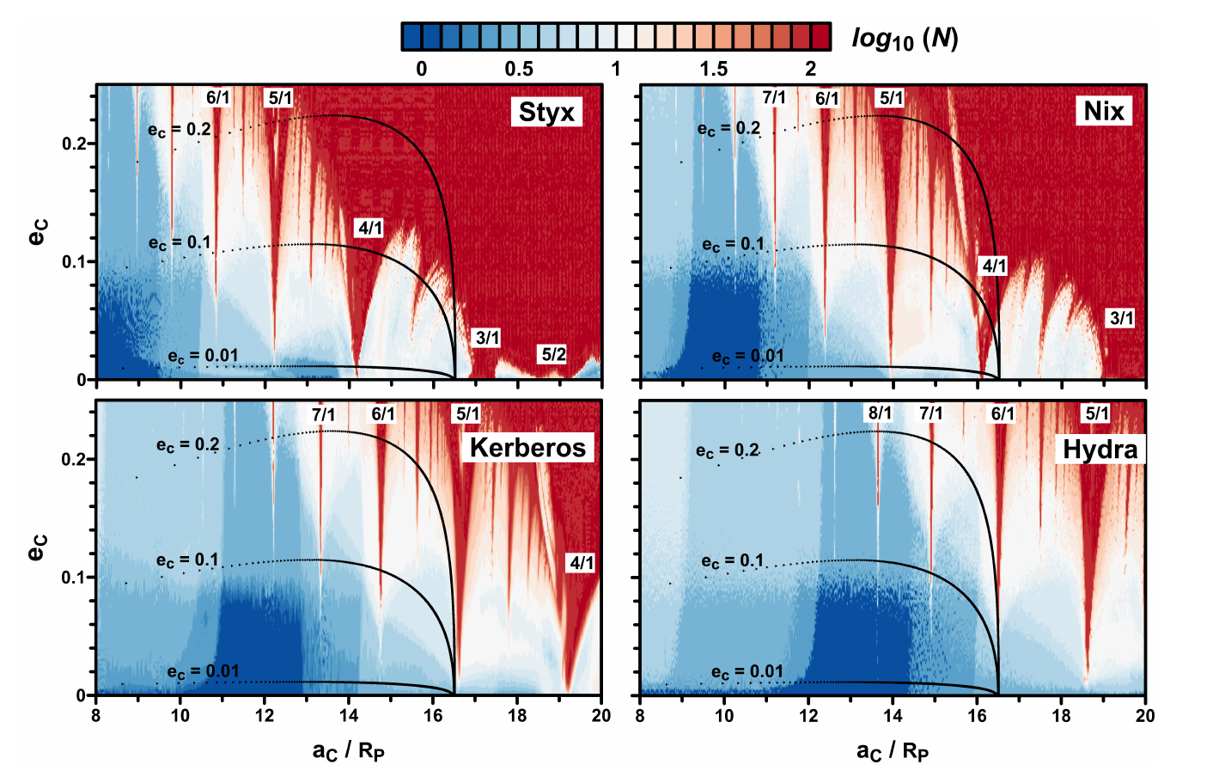
Evolution of Pluton Charon with dynamical maps

Slide 39
Evolution of Pluton Charon with dynamical maps

Slide 40
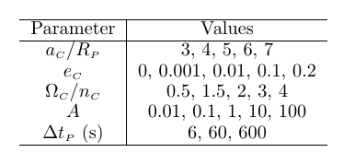
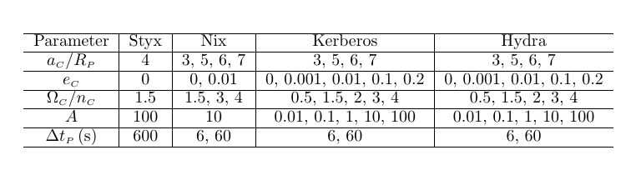
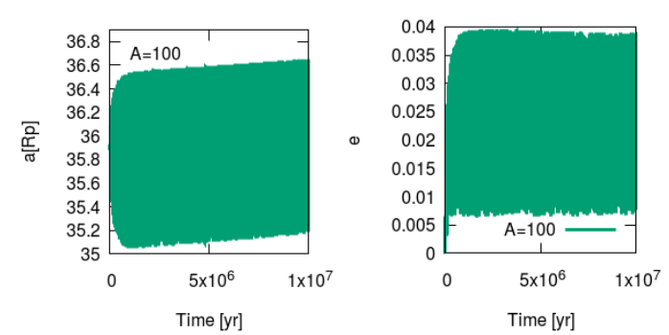
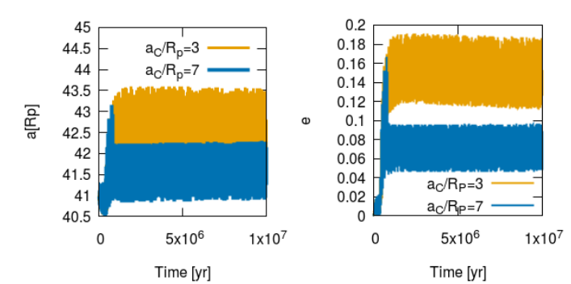
Testing the evolution of small moons at actual positions
No combination of parameters allows survival of moons under tidal expansion of PC.
Resonances with the binary triggers instabilities.

Slide 41
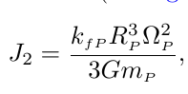

Realistic model with J2 (oblateness of Pluto)
After the impact, rotational flattening and internal uneven mass distribution give
non-zero gravitational harmonic coefficients
Particles not survive at Styx, Nix locations when J2 is considered

Slide 42

Realistic model with J2 (oblateness of Pluto) + Accreting mass of Charon after the collision
T_{acc} = 10⁴ yr since the giant impact, Growth models
m₀ = 60% M_{P}

Slide 43

Realistic model with J2 (oblateness of Pluto) + Accreting mass of Charon after the collision
T_{acc} = 10⁴ yr since the giant impact, Growth models
m₀ = 60% M_{P}
L not longer conserved and necessary fine tune to obtain final position of Charon

Slide 44

Realistic model with J2 (oblateness of Pluto) + Accreting mass of Charon after the collision
Survival of particles at Styx
Survival of particles at Nix

Slide 45

Realistic model with J2 (oblateness of Pluto) + Accreting mass of Charon after the collision
Survival of particles at Styx
Survival of particles at Nix

Slide 46

Realistic model with J2 (oblateness of Pluto) + Accreting mass of Charon after the collision
Which are the physical parameters that determine survival of particles? e_{c} and A

Slide 47

Realistic model with J2 (oblateness of Pluto) + Accreting mass of Charon after the collision
Which are the physical parameters that determine survival of particles?

Slide 48

Realistic model with J2 (oblateness of Pluto) + Accreting mass of Charon after the collision
Results from an uniform disk with distribution of A values for a given accreting time
All the particles in the region survive.
Particles with a~a_{moons} have lower values of e

Slide 49

Realistic model with J2 (oblateness of Pluto) + Accreting mass of Charon after the collision
Results from an uniform disk with distribution of A values for a given accreting time
All the particles in the region survive.
Particles with a~a_{moons} have lower values of e
Initial inclined disk produce more inclined particles near the PC binary

Slide 50
Conclusions
The resonant structure around the PC binary exhibits N/1 and N/2 resonances, although most of them are weak in the low eccentricity and low inclination regimes.
The 3/1 MMR is the most strong circumplanetary resonance even for low eccentricity and inclination of the moons.
The current orbital configuration of the system does not show dynamical preferences of stable motion within the N/1 resonances, despite the four small moons are currently located close to the 3/1, 4/1, 5/1 and 6/1 MMRs.
In the case of accreting Charon mass and considering an evolving J2 with dissipation coefficient A > 14, we find that the small moons can survive the rapid evolution of the Pluto-Charon system and the unlikely resonant transport of particles is no longer necessary.

Slide 52


Slide 53

Pluto - Charon , orbit spin

